Slide 1

Linked list

Slide 2
What is Linked list ?
A linear collection of self-referential objects, called nodes, connected by other links.
A linked list is a series of connected nodes (structures), which are not necessarily adjacent in memory.
Each node in a linked list contains 2 fields :
i) Data field : store the data elements.
ii) Pointer field : store the address of the next node.
DATA | POINTER •
A linked list can grow or shrink in size as the program runs.

Slide 3
Important terms related to Linked list
Linear: For every node in the list, there is one and only one node that precedes it (except for possibly the first node, which may have no predecessor,) and there is one and only one node that succeeds it, (except for possibly the last node, which may have no successor).
Self-referential: A node that has the ability to refer to another node of the same type, or even to refer to itself.
Node: A node contains data of any type, including a reference to another node of the same data type, or to nodes of different data types.

Slide 4
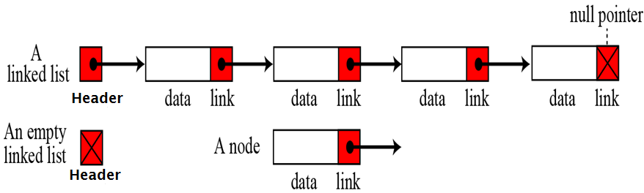
The composition of a Linked List
A linked list is called "linked" because each node in the series has a pointer that points to the next node in the list.
Header: pointer to the first node
The pointer field of the last node contains the sentinel value (NULL in C).

Slide 5
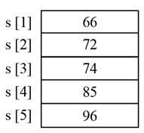
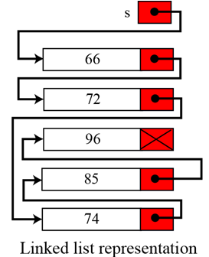
Arrays versus linked lists
Both an array and a linked list are representations of a list of items in memory. The only difference is the way in which the items are linked together.

Slide 6
Arrays versus linked lists
Array
Linked-list
Static memory allocation.
Contiguous memory allocation.
Elements can be accessed using index.
Random access possible.
No loss of data.
Dynamic memory allocation.
Non-contiguous memory allocation.
Elements can be accessed using (following ) pointer.
Only sequential access possible.
If any link lost the rest of the data will lost.

Slide 7
Types of Linked List
There are 4 types of linked list :
Single/ Linear/ One-way linked list .
Doubly / Two-way linked list .
Circular linked list
Double Circular linked list.

Slide 8
Operations on Linked List
Is Empty: determine whether or not the list is empty
Insert Node: insert a new node at a particular position
In head or start
In middle
At end or tail
Traversing through the linked list.
Find Node: find a node with a given value
Delete Node: delete a node from a particular position
From head or start
From middle
From end or tail
Display List: print all the nodes in the list

Slide 9
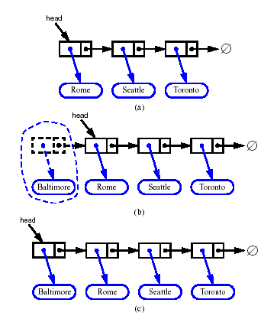
Inserting at the Head (front)
Allocate a new node
Insert new element
Make new node point to old head
Update head to point to new node

Slide 10
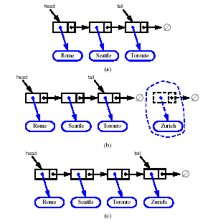
Inserting at the Tail (rear)
Allocate a new node
Insert new element
Have new node point to null
Have old last node point to new node
Update tail to point to new node

Slide 11
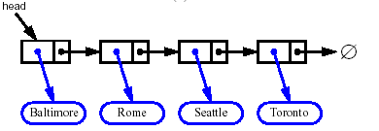


Removing from the Head
Update head to point to next node in the list
Allow garbage collector to reclaim the former first node

Slide 12
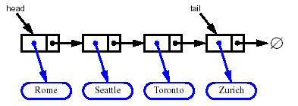
Removing from the Tail
Removing at the tail of a singly linked list cannot be efficient!
There is no constant-time way to update the tail to point to the previous node

Slide 13

Pointer-Based Linked Lists
A node in a linked list is usually a struct
struct Node
{ int info
Node *next;
}; //end struct
A node is dynamically allocated
Node *ptr;
ptr = (node *)malloc(sizeof(Node));
A node

Slide 14
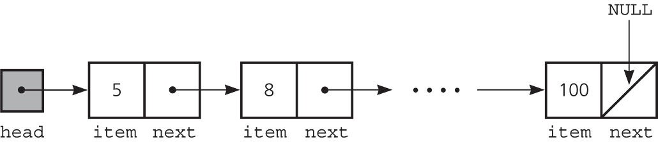
Pointer-Based Linked Lists
The head pointer points to the first node in a linked list
If head is NULL, the linked list is empty
head=NULL
head=malloc(sizeof(Node))

Slide 15
Traverse a Linked List
Reference a node member with the -> operator
p->item;
A traverse operation visits each node in the linked list
A pointer variable cur keeps track of the current node
for(Node *cur = head; cur != NULL; cur = cur->next)
x = cur->item;

Slide 16
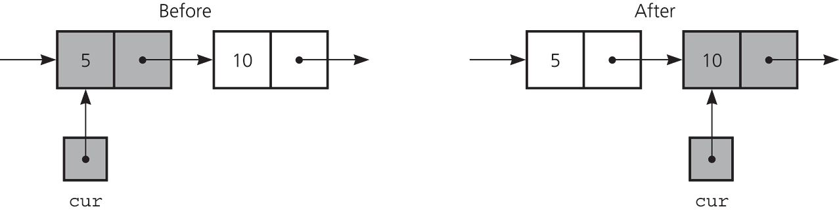
Traverse a Linked List
The effect of the assignment cur = cur->next

Slide 17
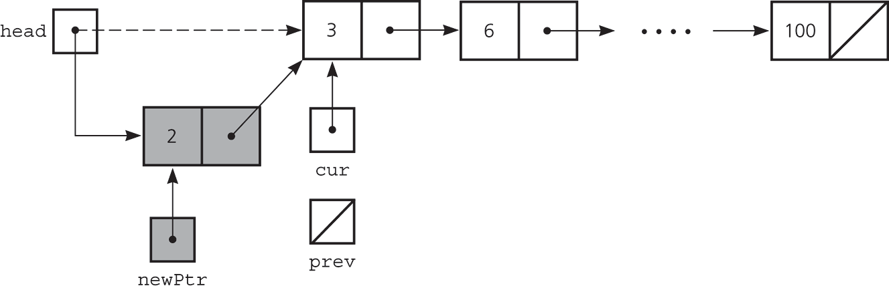
Insert a Node into a Linked List
To insert a node at the beginning of a linked list
newPtr->next = head;
head = newPtr;
Inserting at the beginning of a linked list

Slide 18
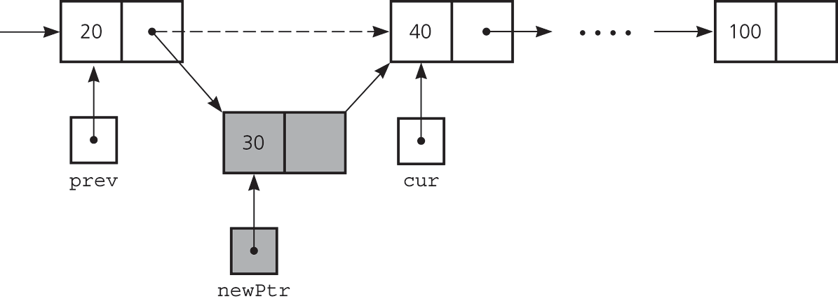
Insert a Node into a Linked List
To insert a node between two nodes
newPtr->next = cur;
prev->next = newPtr;
Inserting a new node into a linked list

Slide 19
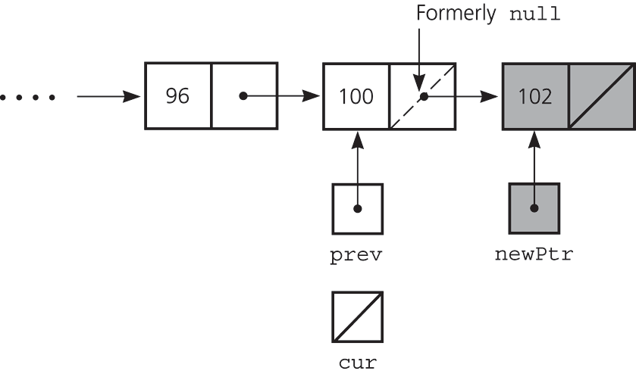
Insert a Node into a Linked List
Inserting at the end of a linked list is not a special case if cur is NULL
newPtr->next = cur;
prev->next = newPtr;
Inserting at the end of a linked list

Slide 20
Delete a Node from a Linked List
Deleting an interior/last node
prev->next=cur->next;
Deleting the first node
head=head->next;
Return deleted node to system
cur->next = NULL;
free(cur);
cur=NULL;

Slide 21
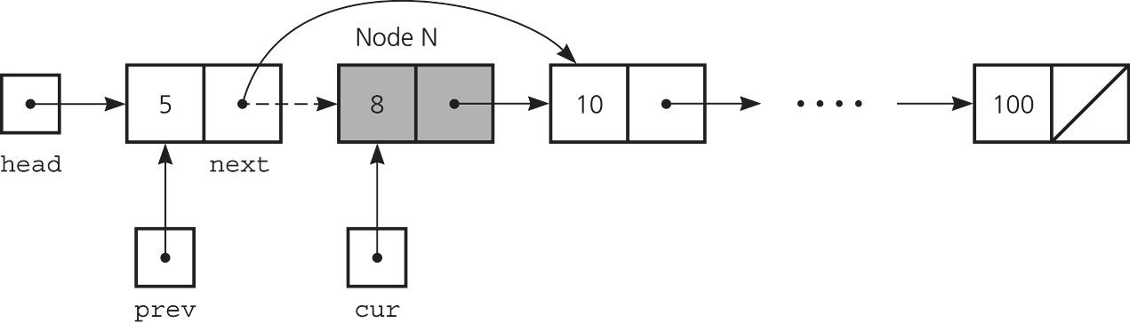
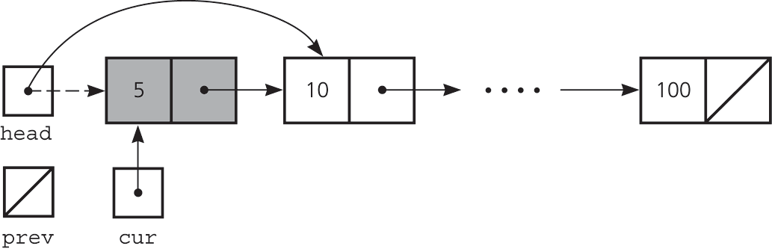
Delete a Node from a Linked List
Deleting a node from a linked list
Deleting the first node

Slide 22
Variations of Linked Lists
Circular linked lists
The last node points to the first node of the list
How do we know when we have finished traversing the list? (Tip: check if the pointer of the current node is equal to the head.)
A
B
C
Head

Slide 23
Variations of Linked Lists
Doubly linked lists
Each node points to not only successor but the predecessor
There are two NULL: at the first and last nodes in the list
Advantage: given a node, it is easy to visit its predecessor. Convenient to traverse lists backwards
∅
A
B
C
∅
Head

Slide 24
Initialization of linked-list
struct node
{ int d;
struct node *n;
}
struct node *f=NULL;

Slide 25
Insert beg()
{ struct node *q;
q=(struct node*) malloc sizeof(struct node));
printf(“Enter any value : “);
scanf(“%d”, &q->d);
if(f==NULL)
{ q->n=NULL;
f=q;
}
else
{ q->n=f;
f=q;
}

Slide 26
Insert end()
{ struct node *q;
q=(struct node*) malloc sizeof (struct node));
printf(“Enter any value : “);
scanf(“%d”, &q->d);
if(f==NULL)
{ q->n=NULL;
f=q;
} else
{ t=f;
while(t->n!=NULL)
t=t->n;
q->n=NULL;
t->n=q;
}

Slide 27
Insert mid() //at position 2
{ int p=2,i=0;
struct node *q;
q=(struct node*) malloc sizeof (struct node));
printf(“Enter any value : “);
scanf(“%d”, &q->d);
if(f==NULL)
{ q->n=NULL;
f=q;
} else
{ t=f;
while((t->n!=NULL) && (i++<p))
t=t->n;
q->n=t->n;
t->n=q; }}
}

Slide 28
del front()
{ struct node *t;
if(f==NULL)
printf(“Deletion not possible”);
else
{
t=f;
printf(“Deleted node value is %d”,t->d);
f=t->n;
free(t);
}
}

Slide 29
del end() // using single pointer
{ struct node *t;
if(f==NULL)
printf(“Deletion not possible”);
else
{ if(t->n==NULL)
{ f=NULL;
free(t);
}
else
{
while(t->n->n != NULL)
t=t->n;
free(t->n);
t->n=NULL;
}
}

Slide 30
del end() // using double pointer
{ struct node *t, *t1;
if(f==NULL)
printf(“Deletion not possible”);
else
{ if(t->n==NULL)
{ f=NULL;
free(t);
}
else
{
t1=t->n;
while(t1->n != NULL)
{
t1=t1->n;
t=t->n;
}
free(t1);
t->n=NULL;
}
}
}

Slide 31
del mid() // using double pointer
{
int num;
struct node *t, *t1;
t=f;
if(f==NULL)
printf(“Deletion not possible”);
else
{
printf(“Enter value: “);
Scanf(“%d”,&num);
t1=t->n;
while((t1->d != num) && (t1->n!=NULL))
{
t1=t1->n;
t=t->n;
}
}
if(t1->d==num)
{ f->n=t1->n;
free(t1);
}
}

Slide 32
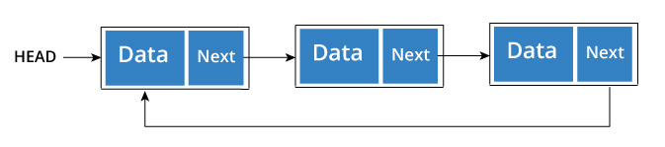

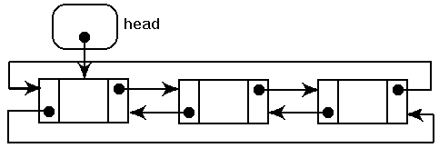
Circular linked list
Operations : Do by yourselves.
Double linked list
Operations : Do by yourselves.
Double circular linked list

Slide 33
Polynomial
7x⁴ + 9x² + 5x +2
Array representation
Linkedlist representation
7 | 0 | 9 | 5 | 2
Coeff 4 3 2 1 0
Co-eff
7 | 4
9 | 2
5 | 1
2 | 0 | X
Power
Head

